Slide 1
CSS HACKS
Category : Fin-Tech
Project : Analyzer-Enhancer for Productivity & Efficiency

Slide 2
Problem Statement :-
As more large teams work remotely, develop a solution for the managers to find out how engaged their staff are and check on their physical and emotional welfare. Other than the traditional method of video conference, how might we utilize data to enable remote tracking of employee engagement and mental well being on a real time basis for employees in the financial sector? Develop a solution to address the same.

Slide 3
Chief-Objectives :
(1) Behavioural analysis of the workers through
Fatigue / Inactivity Monitoring using Webcam
and Smart-Watch.
(2) Publish Bi-weekly report on average employee
efficiency Index.
(3) Improve company growth index through one to one
engagement with employees regarding their
performance over a stipulated period as decided by
the company ( preferably Bi-Weekly ).

Slide 4
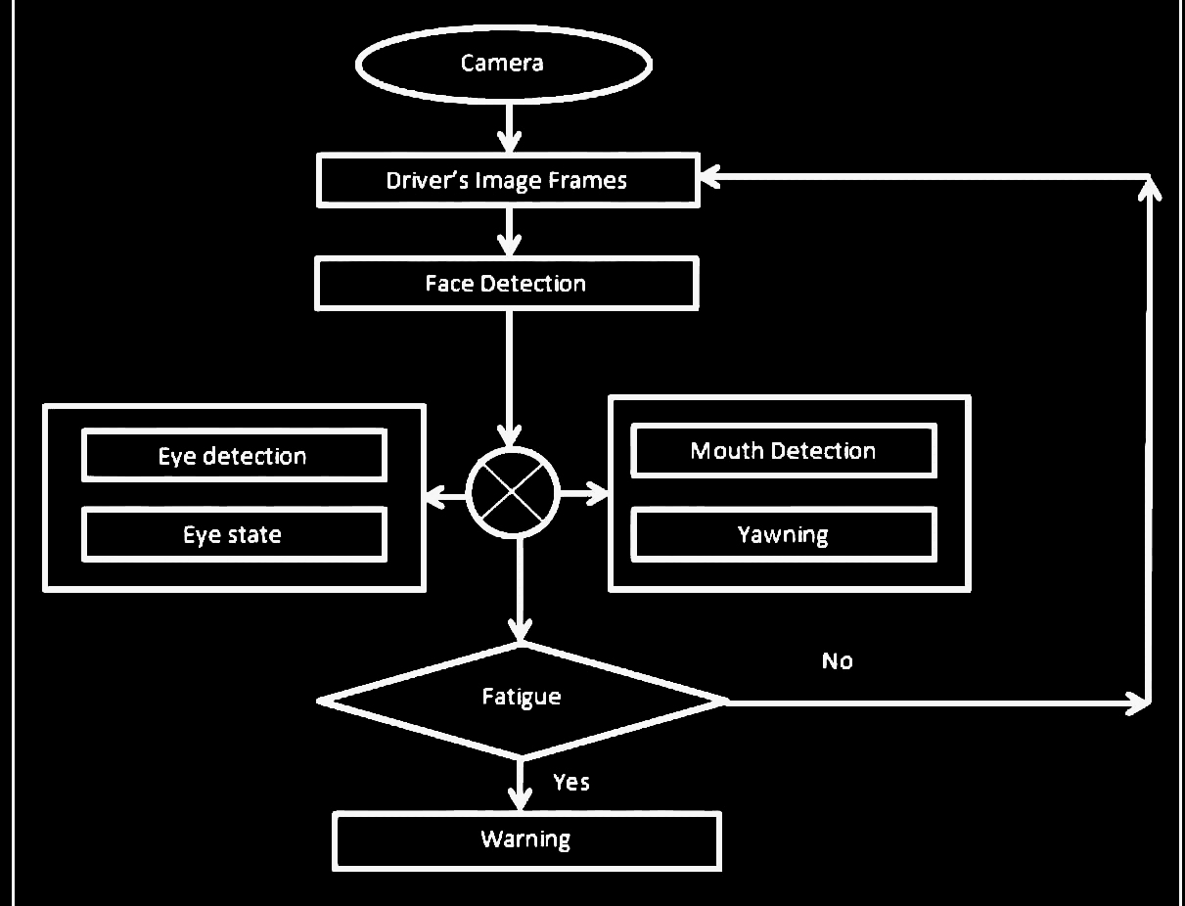
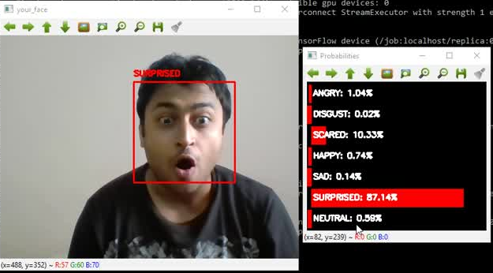
Proposed Fatigue Detection System
Facial Fatigue / Exhaustion Detection System

Slide 5



Fatigue
Detection +
Activity
Monitoring
using
Smart-Watch

Slide 6
THE TEAM
Abhigyan Ballav Baruah - 2012133
Jay Kumar Sahu - 2012122
Sundaram Verma - 2012159
Neelabh Nayan Ray - 2012191

